Slide 1
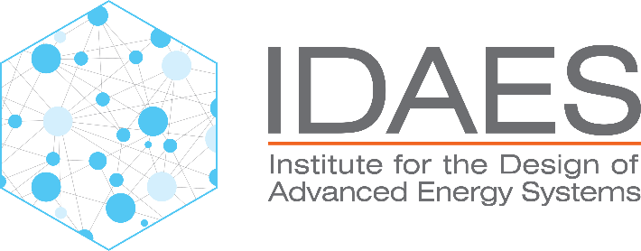
Lithium Extraction with ePC-SAFT 02/13/2026 Tanner Polley

Slide 2
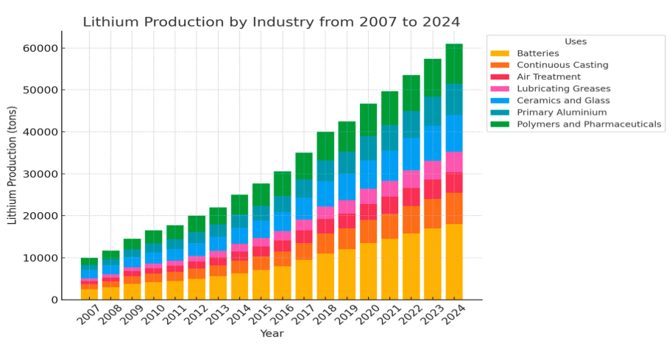
Lithium Demand
Global lithium demand is projected to exceed 2.5 million metric tons of lithium carbonate equivalent (LCE) by 2030, largely driven by electric vehicles and grid-scale storage
Current supply chains rely heavily on South American brines and Australian spodumene, which face both geographic and processing constraints
Produced water from oil and gas wells can contain lithium concentrations ranging from <10 mg/L to more than 400 mg/L, offering significant untapped potential
Valorizing produced water provides dual benefits: meeting lithium demand and offsetting disposal costs for oil and gas operators
Notes:
(1) Almousa, M.; Lim, Y. H.; AlMubaidin, M.; Alshami, A.; Al-Tayyem, B. H.; Tomomewo, O.; Khalifa, H. Comparative Feasibility of Lithium Extraction Technologies in U.S. Oilfields. Desalin. Water Treat. 2025, 322, 101128. https://doi.org/10.1016/J.DWT.2025.101128.

Slide 3
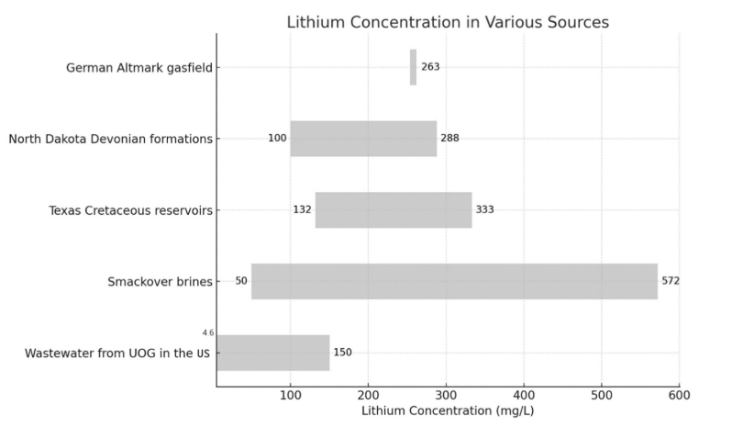
Produced Water
Produced water is the largest waste stream of the oil and gas industry, with global volumes exceeding 250 billion barrels annually
Its composition varies by reservoir: shale gas waters often show lower lithium (<50 mg/L), while certain oilfield brines in North America can exceed 200 mg/L
High salinity levels (TDS often >100,000 mg/L) and competing cations such as Na+, Ca2+, and Mg2+ complicate lithium separation
Targeting reservoirs with higher Li/Na ratios improves economic feasibility
Produced water varies widely in chemistry, meaning not all wells are good candidates. Identifying sweet spots with favorable lithium concentrations and lower interferences is critical to make extraction viable.

Slide 4
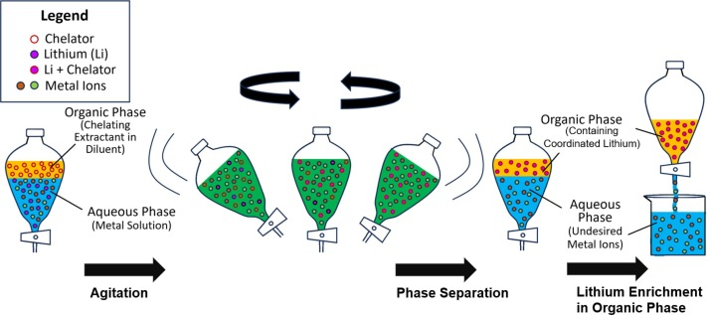
Why Solvent Extraction of Lithium?
Almousa [1] ranked solvent extraction highest among DLE technologies in terms of scalability, cost, and selectivity after a comprehensive review of relevant technologies.
Strengths:
Enables continuous processing
Has high efficiency and selectivity
Can operate under mild conditions
Consumes less energy
Doesn't require highly acidic environments like some alternatives.
Weaknesses:
Complicated Preparation
Necessary Pretreatment for Divalent Cations
Potentially larger capital cost
High waste production
Notes:
(23) Kanagasundaram, T.; Murphy, O.; Haji, M. N.; Wilson, J. J. The Recovery and Separation of Lithium by Using Solvent Extraction Methods. Coord. Chem. Rev. 2024, 509 (December 2023), 215727. https://doi.org/10.1016/j.ccr.2024.215727.

Slide 5

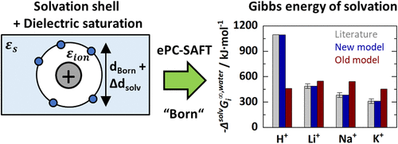
What is ePC-SAFT?
ePC-SAFT (electrolyte Perturbed-Chain Statistical Associating Fluid Theory) is a thermodynamic model that predicts phase behavior in complex electrolyte systems, including ionic liquids.
It accounts for multiple molecular interactions—including dispersion forces, association (like hydrogen bonding), and electrostatics (via Debye–Hückel and Born terms)—giving it wide applicability.
Unlike simpler models, ePC-SAFT is built on a molecular foundation, allowing more accurate prediction of phenomena like ion-pairing, phase separation, and solubility in multicomponent mixtures. It also contains only 2 tunable parameters which is much lower than other existing models for electrolyte solutions
Notes:
(1) Yu, G.; Li, Y.; Zhang, X.; Jovein, I. B.; Figiel, P.; Chen, B.; Ji, Y.; Sadowski, G.; Held, C. Lithium Extraction from Salt-Lake Brines Using Dicationic Ionic Liquids: EPC-SAFT Modeling and Molecular Mechanisms. AIChE J. 2025, 71 (April), e18907. https://doi.org/10.1002/AIC.18907.

Slide 6
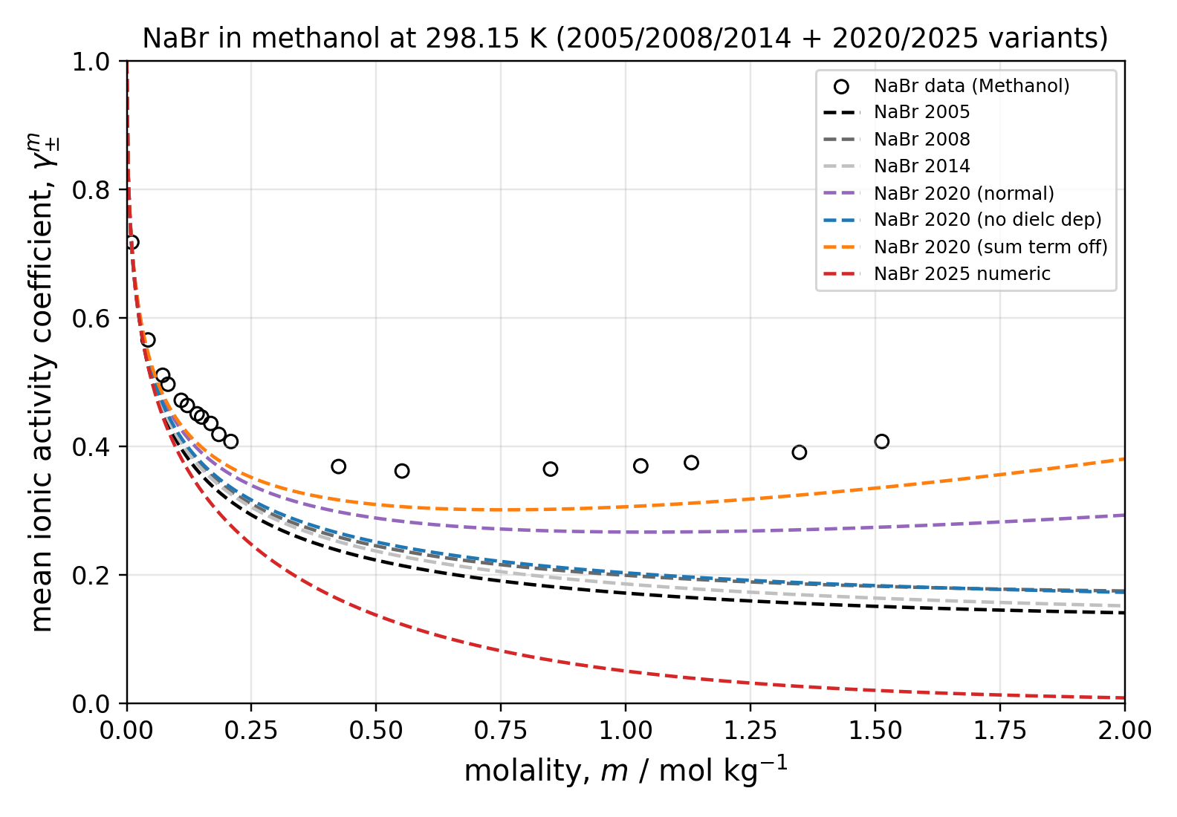
ePC-SAFT Model Timeline
2005: First added the Debye Huckel Term to the PC-SAFT EoS
2008: Retuned pure component parameters
2014: Added binary interaction parameters for ion-ion and ion-solvent interactions
2020: Added concentration dependent dielectric constant and born term
2021: Adds a potential Bjeruum treatment option
2025: Adds the SSM+DS version of the born term (solvation shell model + dielectric saturation)

Slide 7
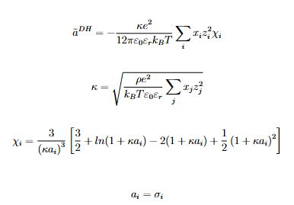

Debye Huckel vs Born
Debye–Hückel (DH): long-range ion–ion electrostatics and screening; primary driver of MIAC trends vs salt level
Born: ion–solvent solvation free energy; becomes critical when moving from water to lower-permittivity solvents
Separating DH and Born makes debugging physical: ion–ion mismatch vs ion–solvent mismatch
Born can be small in mostly-aqueous cases, but it is not optional for mixed-solvent transfer predictions

Slide 8
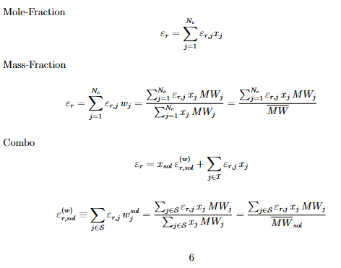
Relative Permittivity
Permittivity sets the “strength” of electrostatics in both DH and Born terms
Constant permittivity can work locally, but it breaks when solvent composition or salt loading shifts ε meaningfully
The 2020 approach treats ε as composition-dependent and includes the needed derivatives for chemical potentials
This is the key ingredient for credible water → alcohol/organic electrolyte predictions

Slide 9
C++ to Python based ePC-SAFT Package Improvements
Side-by-side model presets (2005 / 2008 / 2014 / 2020) to reproduce literature assumptions consistently
A dielectric “engine” with selectable mixing rules and analytic derivatives (with safe numerical fallback)
Altered Born contribution options to match 2020-style composition-dependent ε behavior
Guardrails: SSM+DS-style Born solvation shell + dielectric saturation is not part of the current baseline workflow

Slide 10
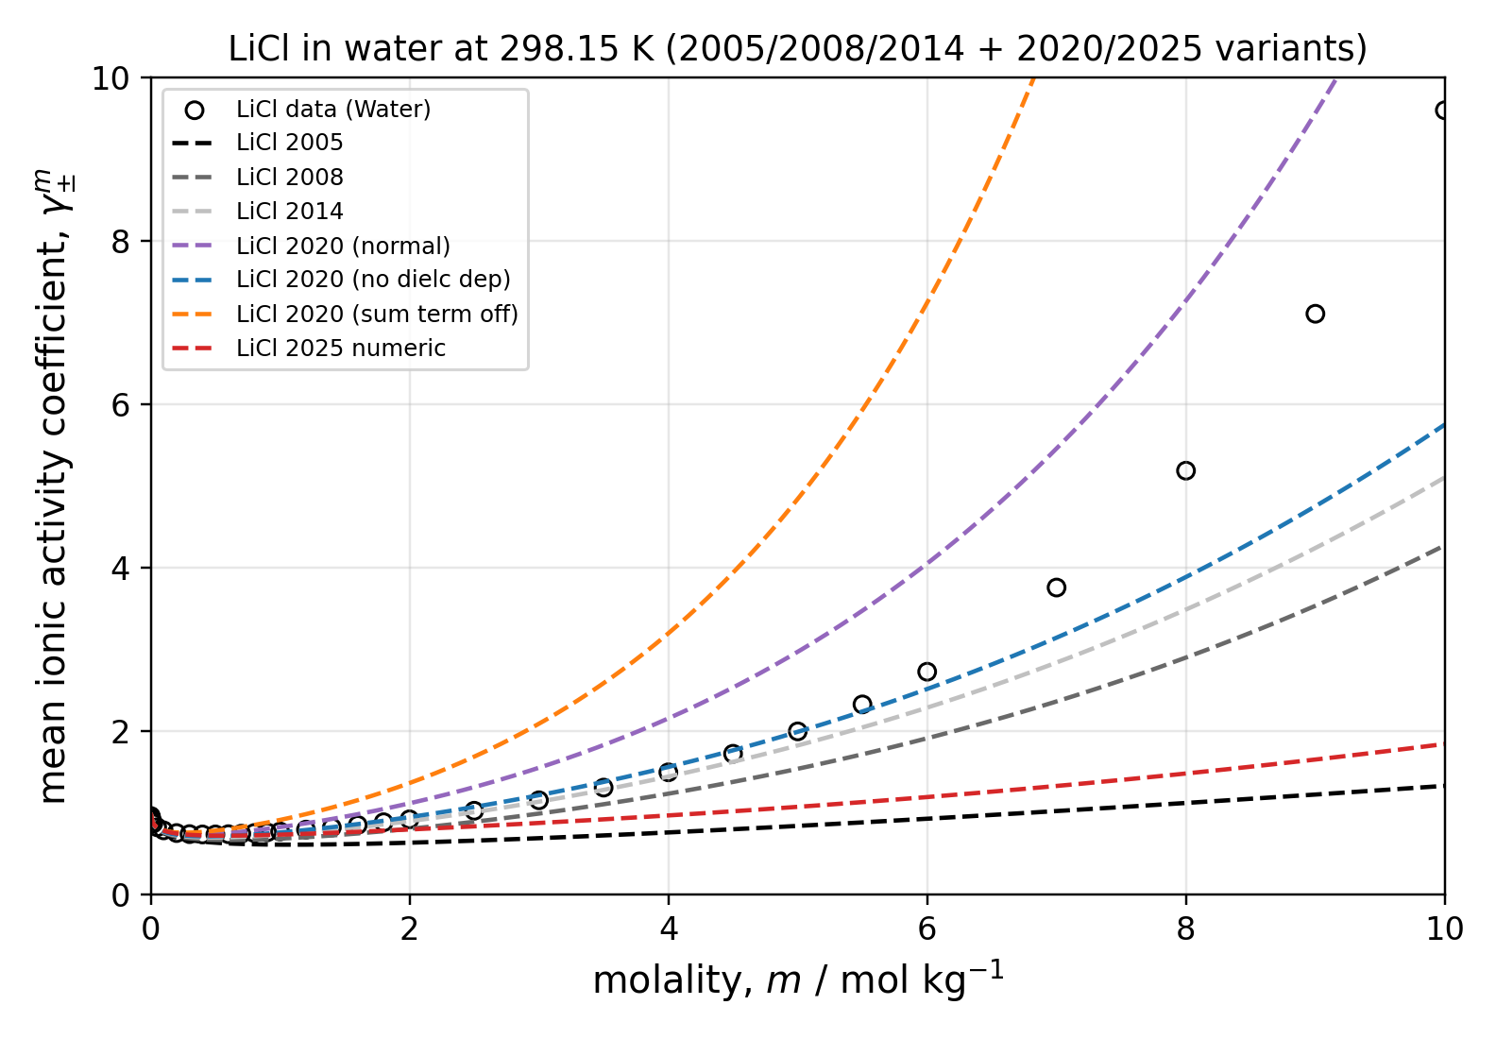
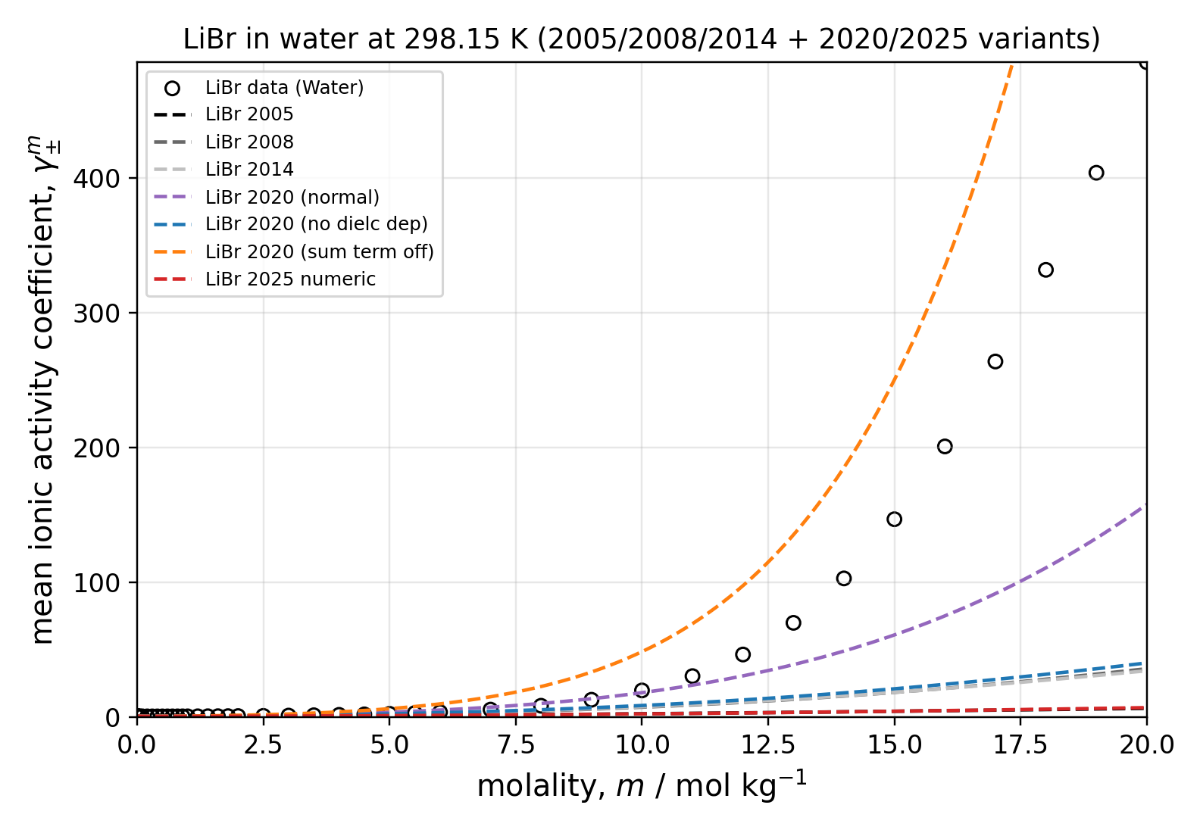
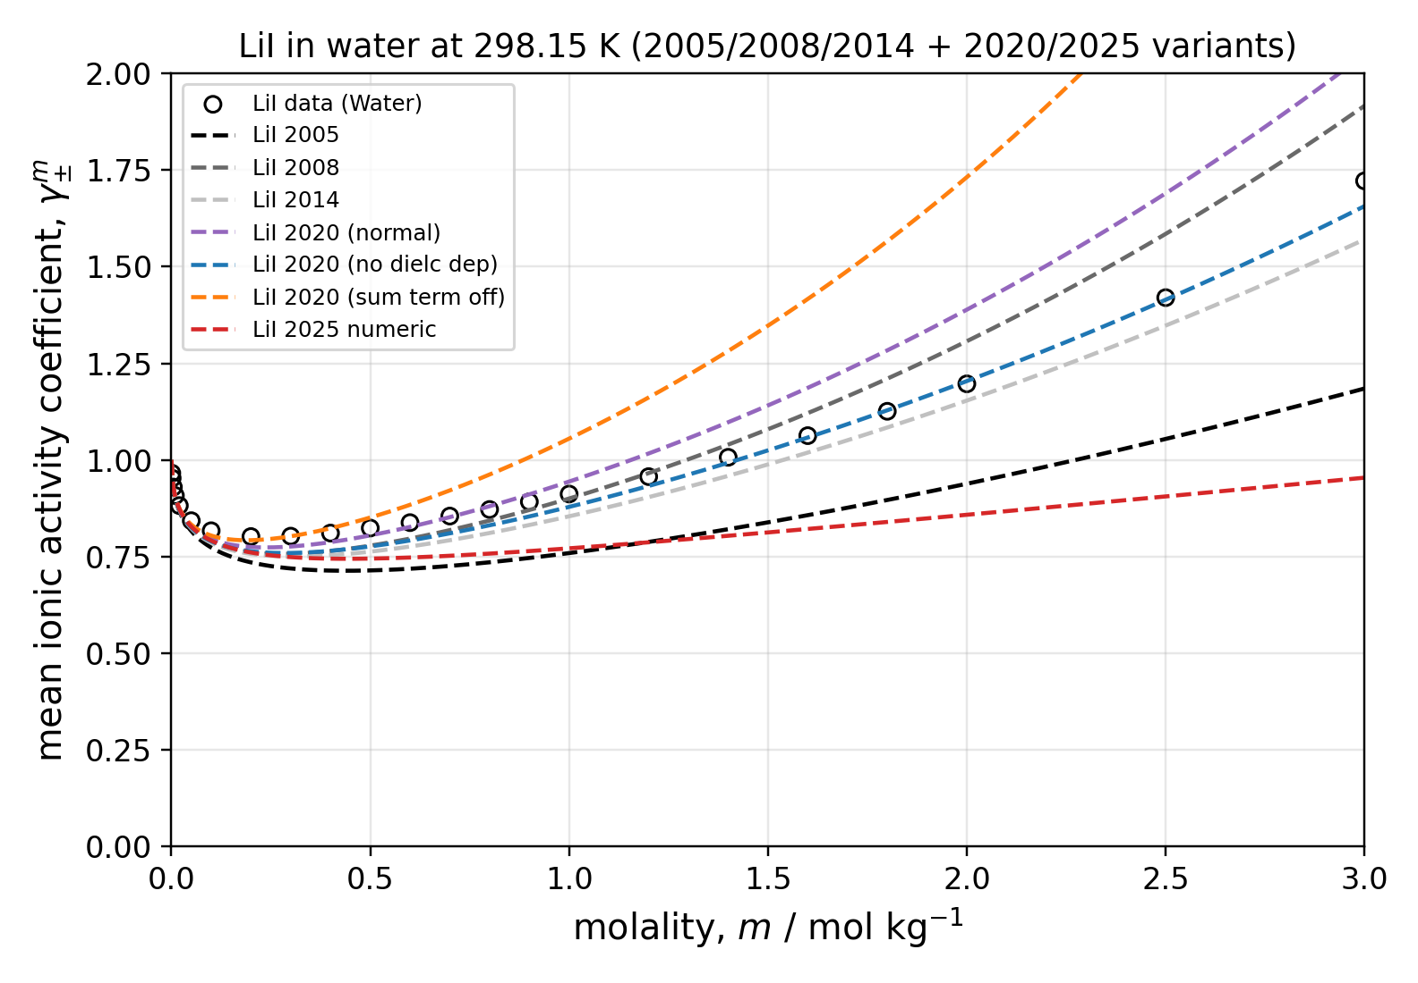
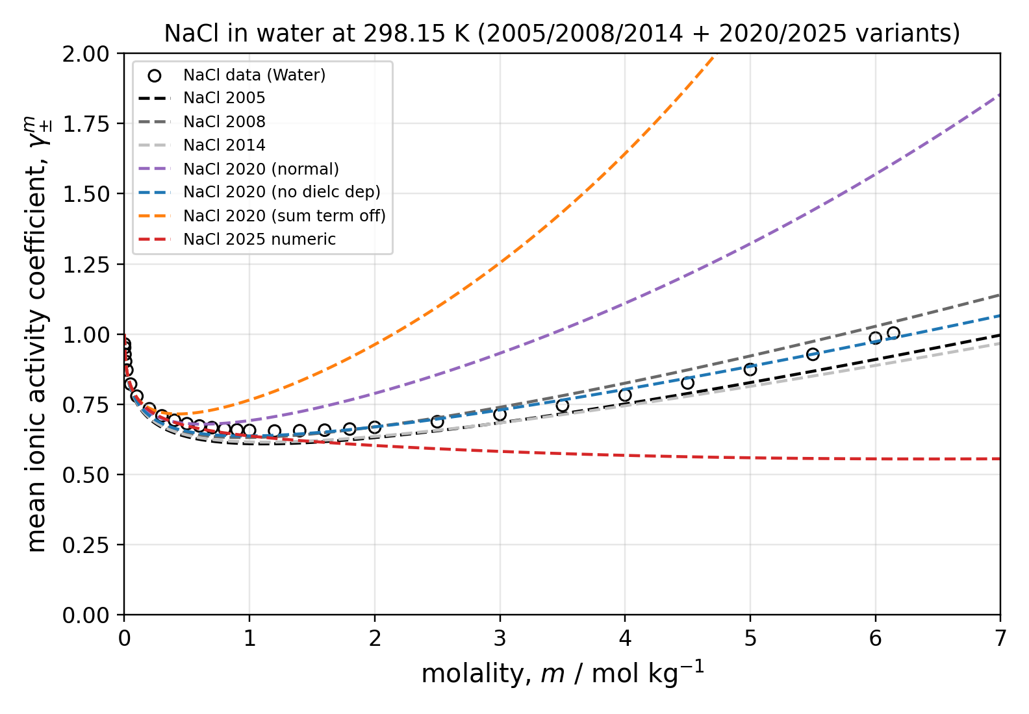
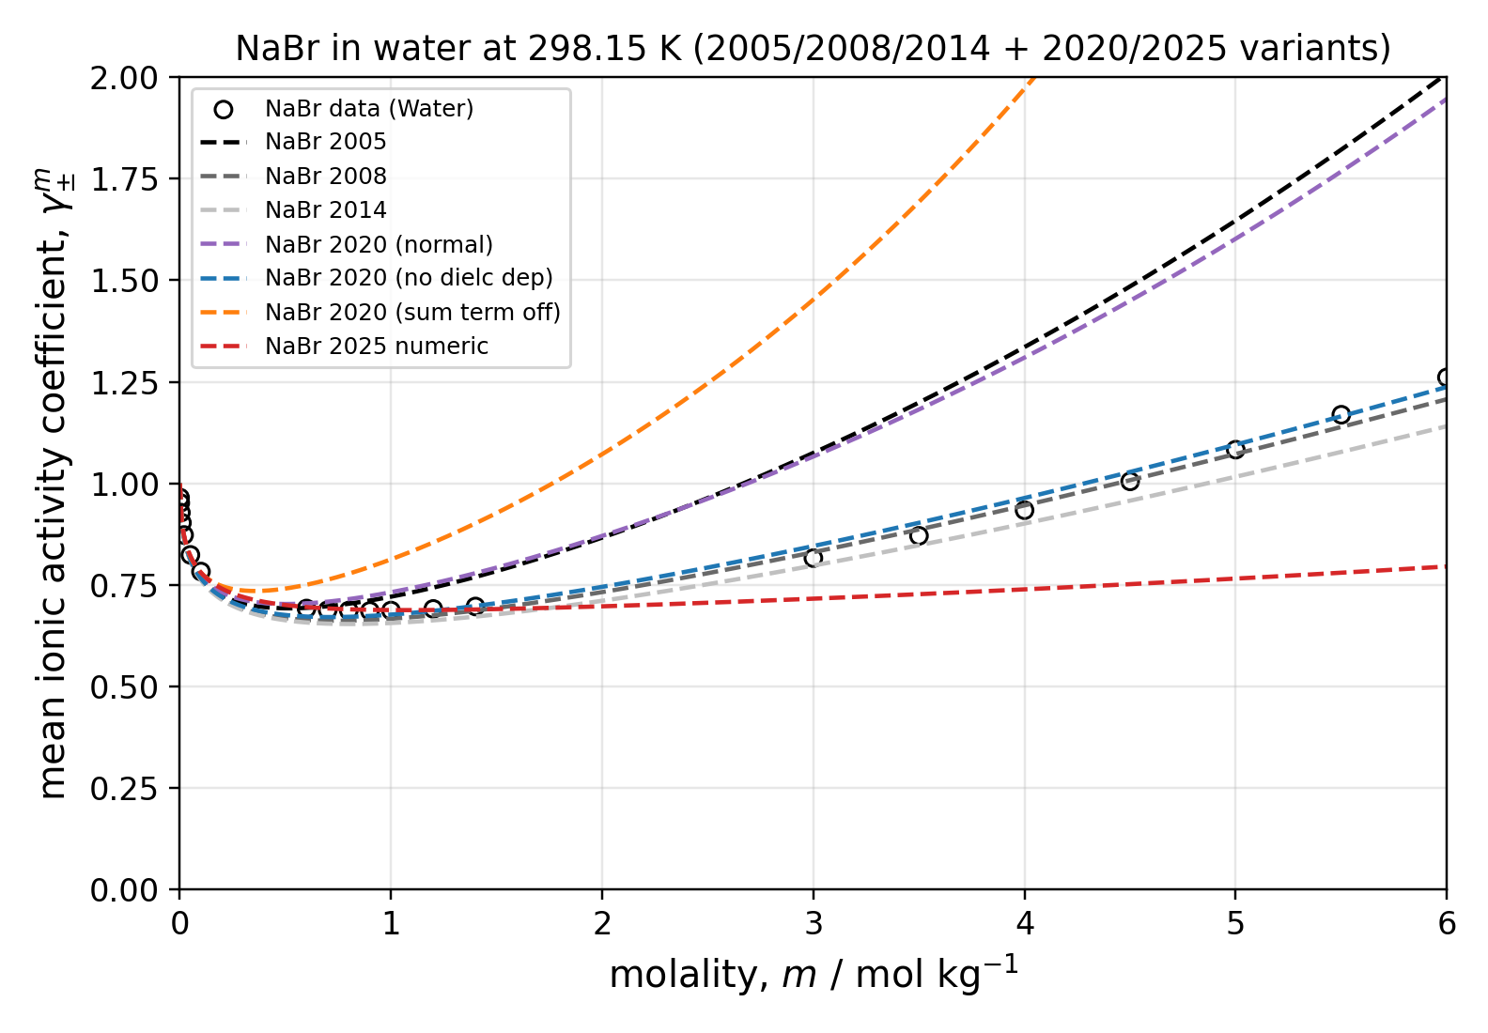
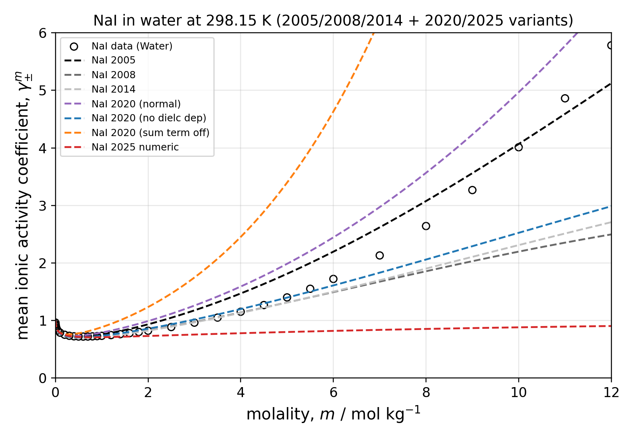
Mean Ionic Activity Coefficient Fits - Water

Slide 11
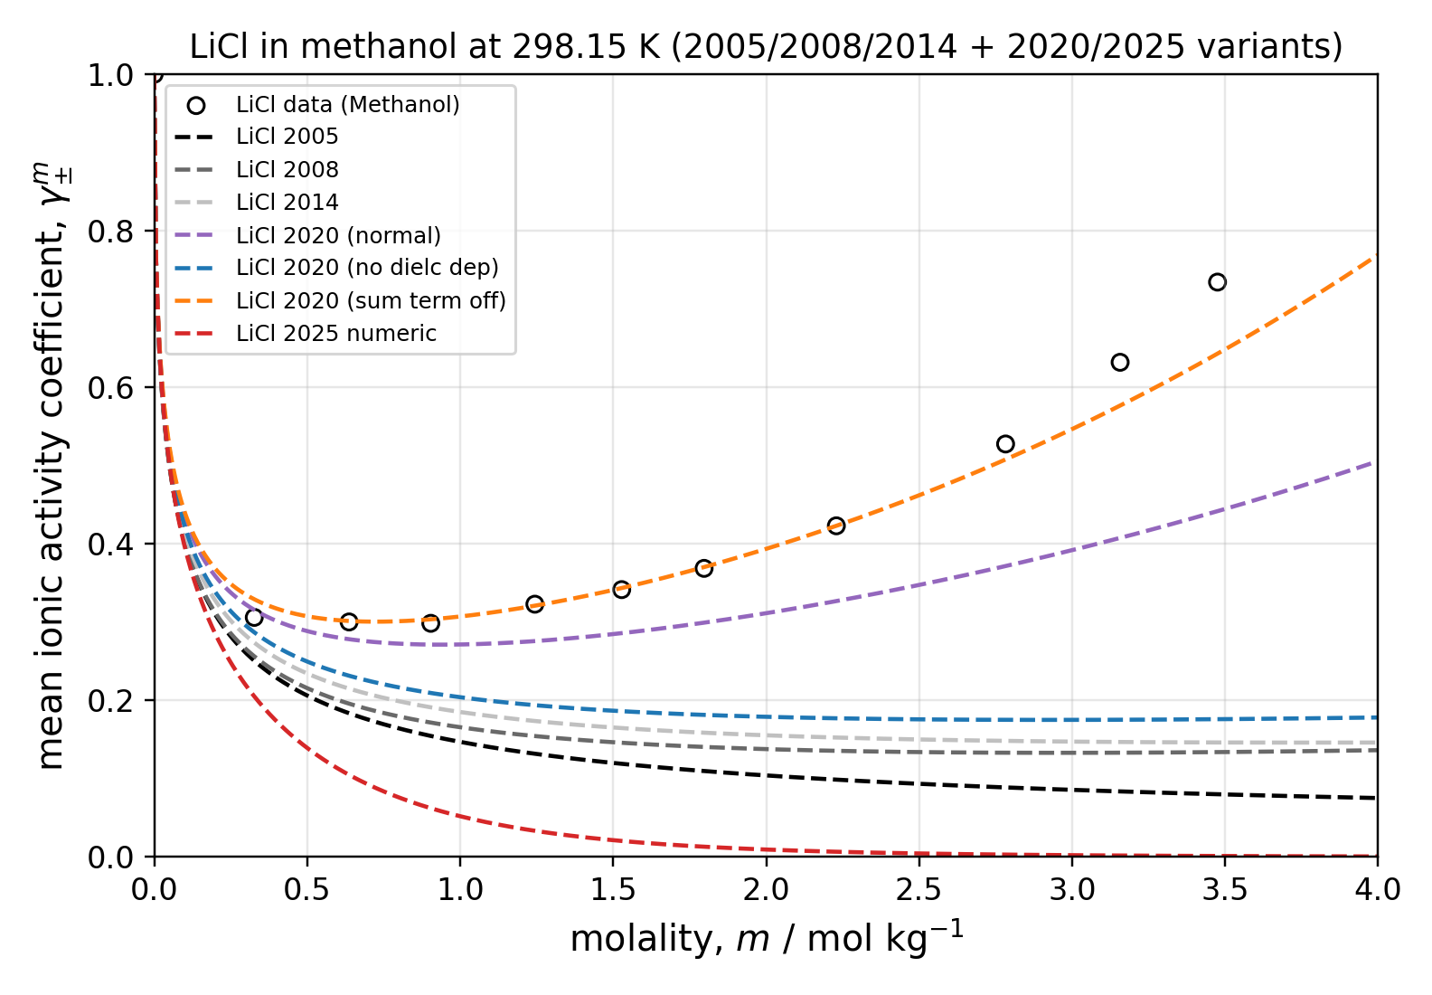
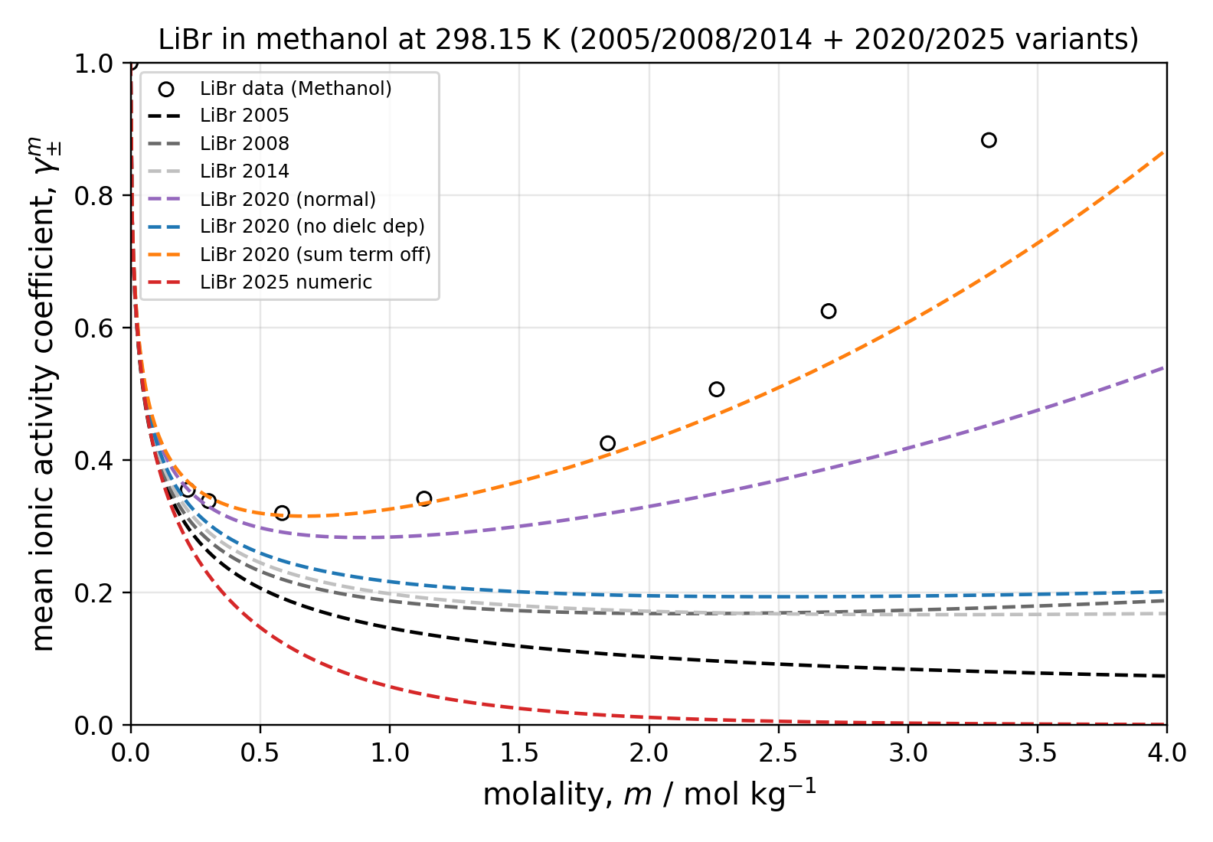
Mean Ionic Activity Coefficient Fits - Methanol

Slide 12
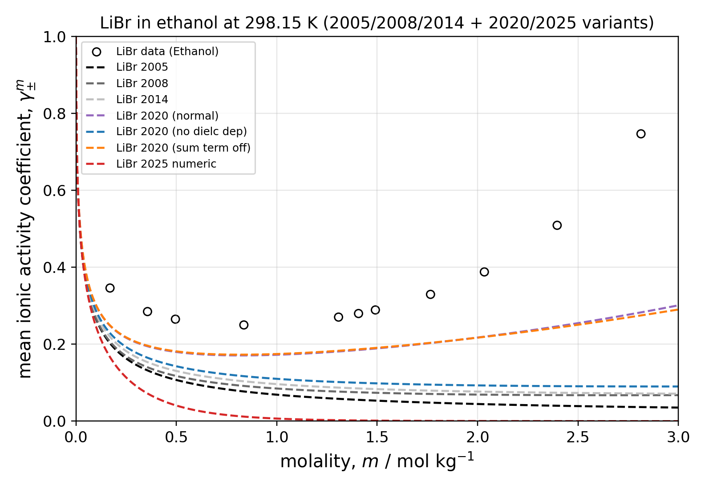
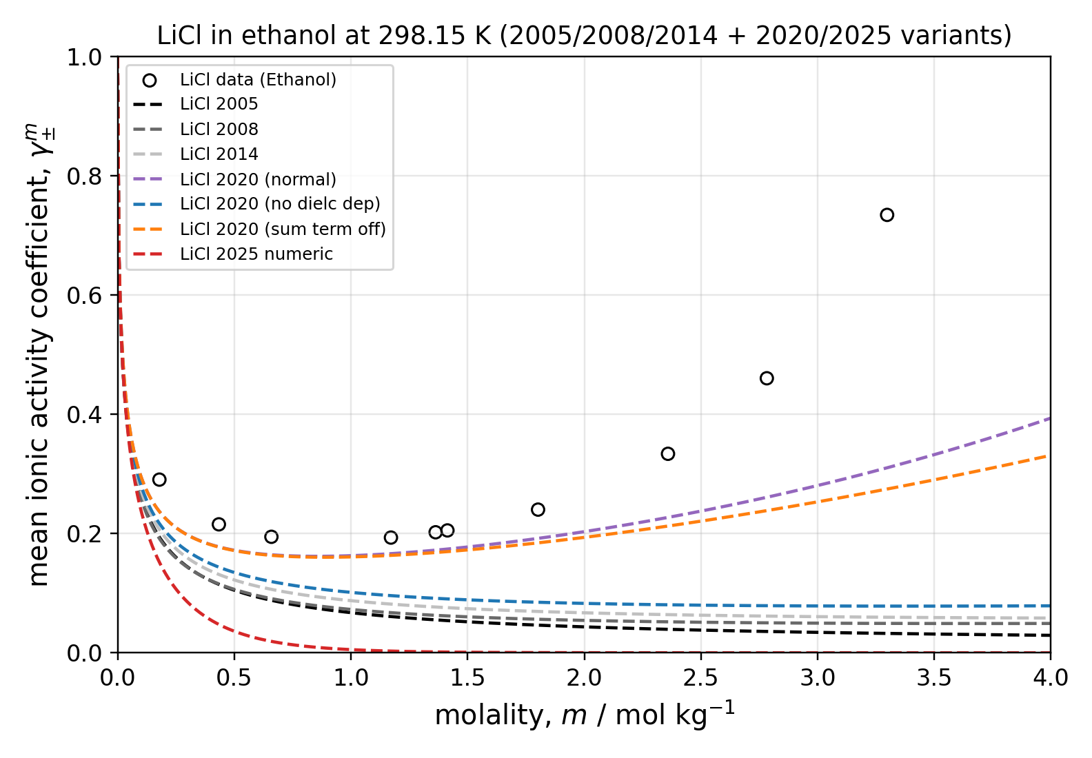
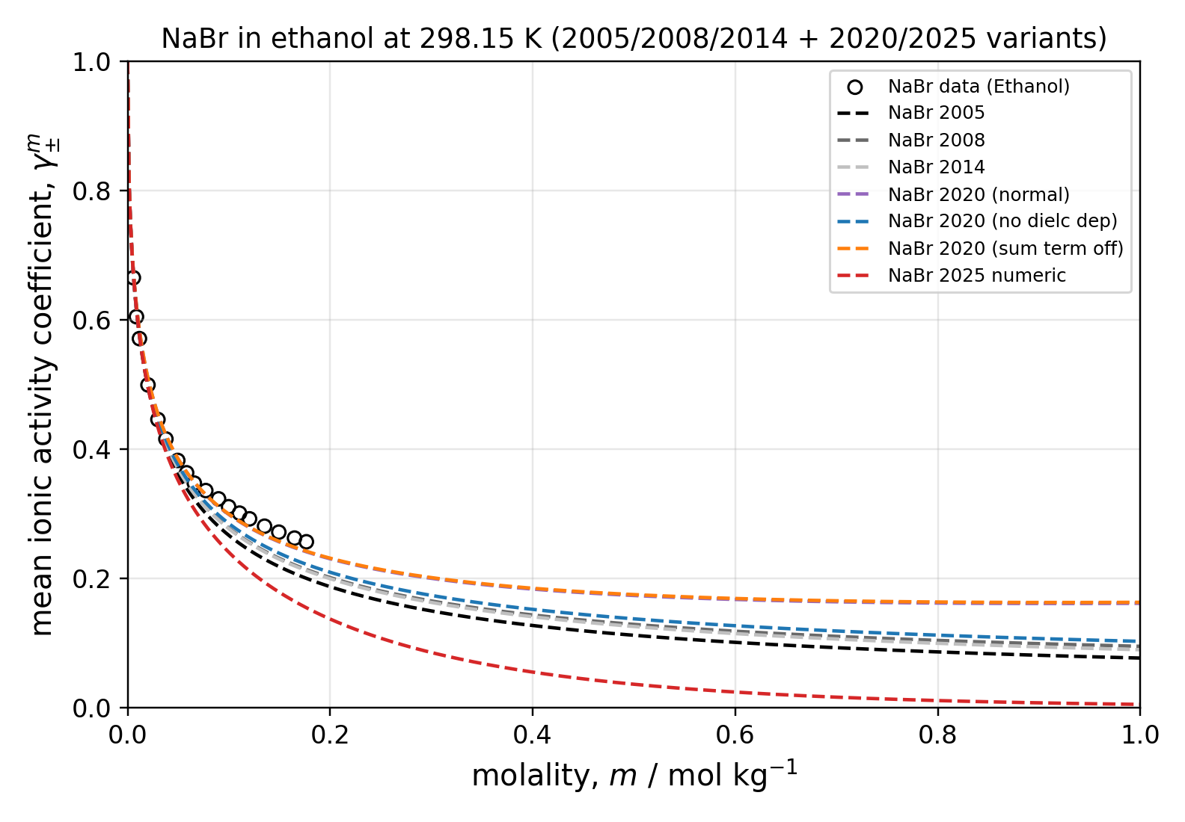
Mean Ionic Activity Coefficient Fits - Ethanol

Slide 13
Why the 2020 Model Is the Best Baseline
Best balance today: strong aqueous grounding plus credible transfer toward non-aqueous/mixed-solvent systems
Keeps the parameter philosophy clean: mostly pure-component/ion parameters with a consistent kij strategy
Avoids adding extra empirical knobs unless the data demands it (better for scale-up and extrapolation)
Sets the right foundation for LLE coupling because electrostatics respond correctly to solvent composition

Slide 14
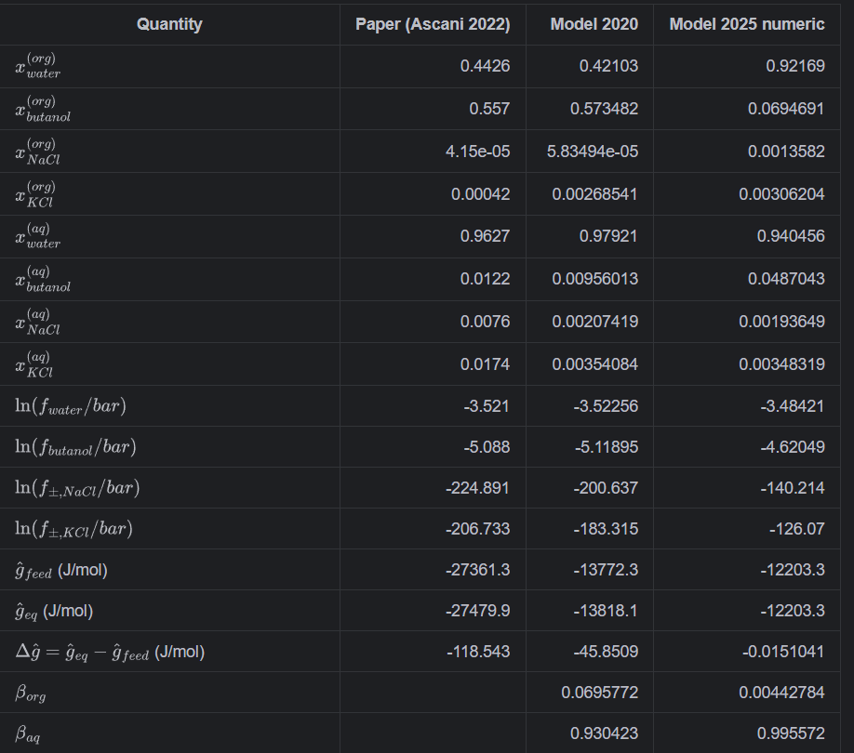
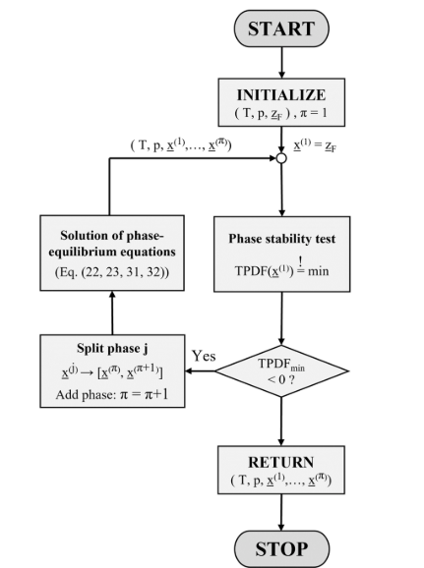
LLE for Solvent Extraction
Inside the PC-SAFT package is a two liquid phase equilibrium algorithm that can take a generic feed composition and determine the existent of two liquid phases and then produce the equilibrium compositions of both the aqueous phase and organic phase
It showcases the possibility of a transfer for an ion from one phase to another

Slide 15
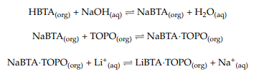
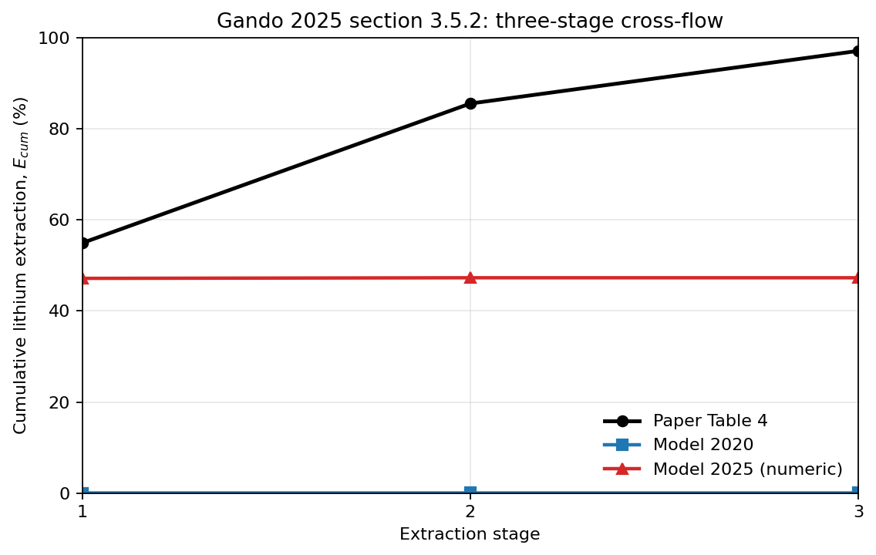
Currently in Progress
Demonstration of Lithium extraction from produced water
Parameters for the specific solvents will be fitted
Determination of which epc-saft model to use to for this specific set of solvents and ions

